Slide 1
LOGO! 0BA7 communication to SIMATIC Panels
Networking with LOGO! 0BA7 to HMI

Slide 2
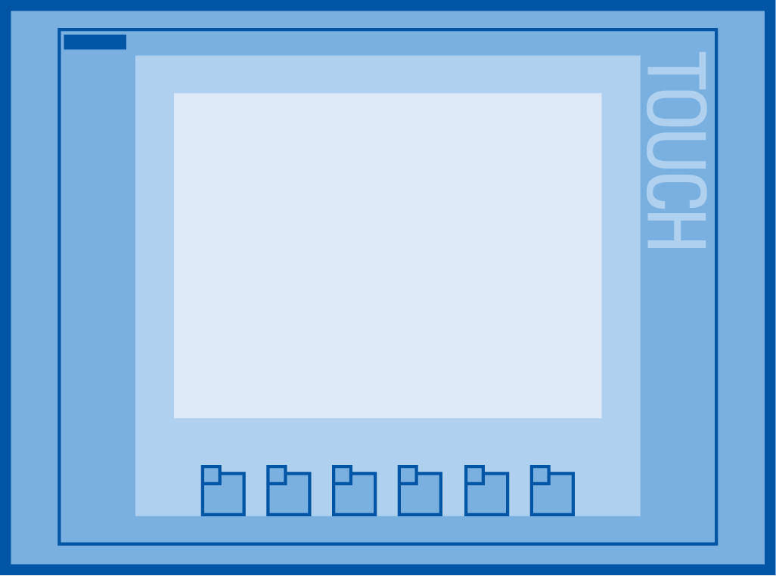
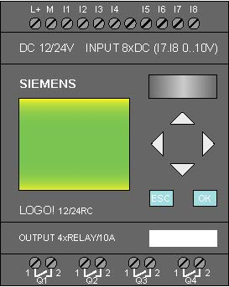
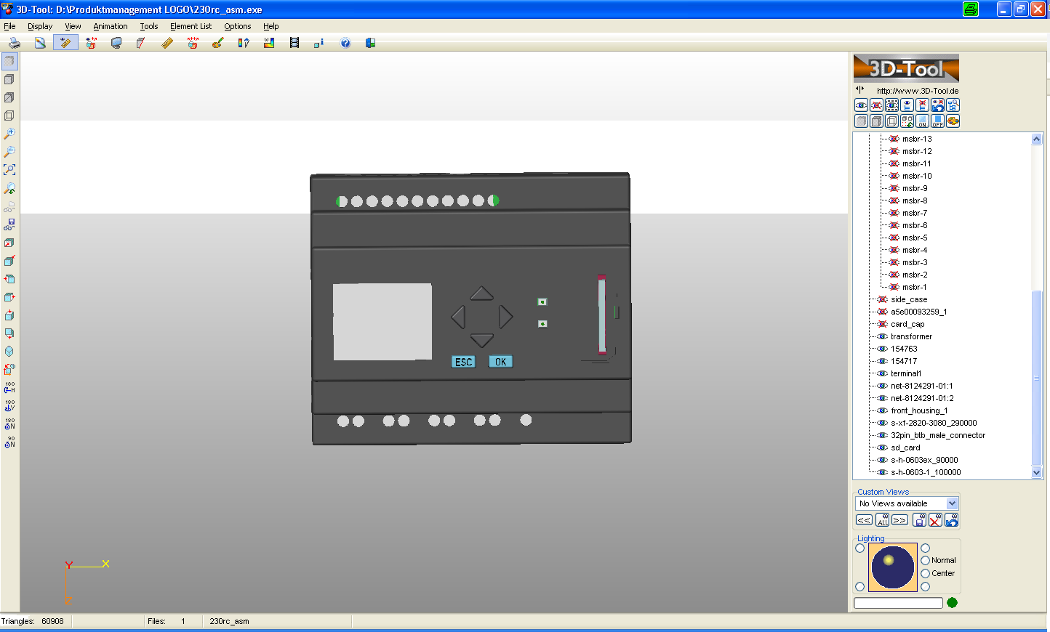
Communication to a Siemens HMI
Siemens HMI with LOGO! 0BA7
E
E
Basics: Communication based on Simatic S7 protocol
Server ⬄ Client communication
HMI device is always Client TSAP of HMI is always 02.00
TSAP: Transport Service Access Point

Slide 3
Communication to a Siemens HMI
Siemens HMI with LOGO! 0BA7
E
E
LOGO! does not know VW xy.
So we need to “map” LOGO! and we need to configure the communication!

Slide 4
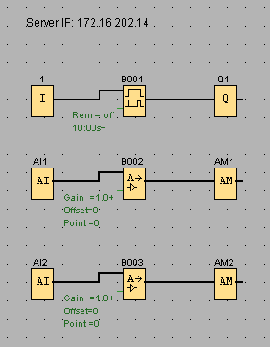
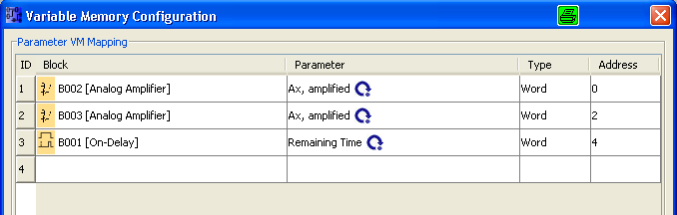
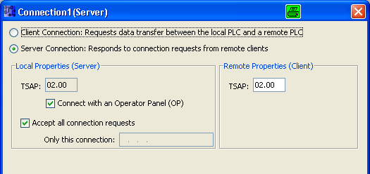
Communication to a Siemens HMI
2
1
3
1
Create the following poor program
3
Configure a Server connection with the following TSAP’s
2
Create the VM-Mapping table

Slide 5
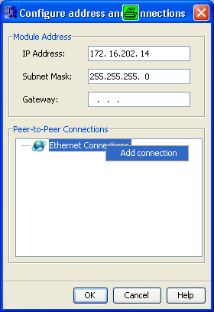
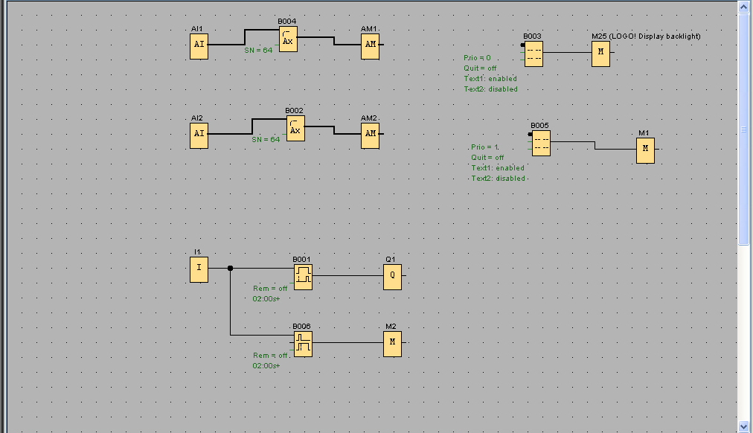
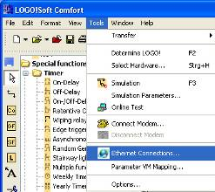
Communication to a Siemens HMI
Siemens HMI with LOGO! 0BA7
1. Configure communication
E
E

Slide 6
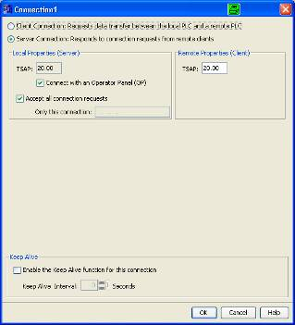
Communication to a Siemens HMI
Siemens HMI with LOGO! 0BA7
1. Configure communication
1
2
3
E
E
4
1
Enable Server connection
Enable Operator Panel
3
Enter TSAP of LOGO! Connection (20.00 .. 27.00)
Enable Keep Alive Interval if wanted
2
4

Slide 7
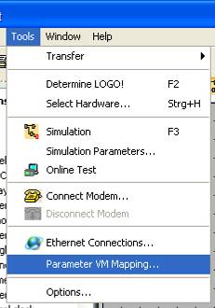
Communication to a Siemens HMI
Siemens HMI with LOGO! 0BA7
2.Specify data
E
E

Slide 8
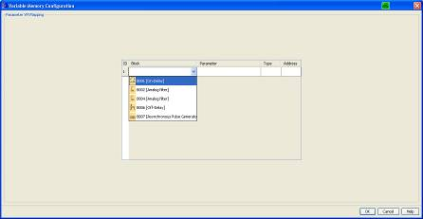

Communication to a Siemens HMI
Siemens HMI with LOGO! 0BA7
2.Specify data
E
E
Function block Parameter Type Address
Configure what data you want to communicate. Max. 32 Values are possible

Slide 9
Communication to a Siemens HMI
Siemens HMI with LOGO! 0BA7
E
E
Use the HMI engineering SW to configure the HMI
WinCC flexible Compact 2008 SP2 (use S7-200 as Controller)
WinCC Basic V11 (use S7-200 driver)

Slide 10
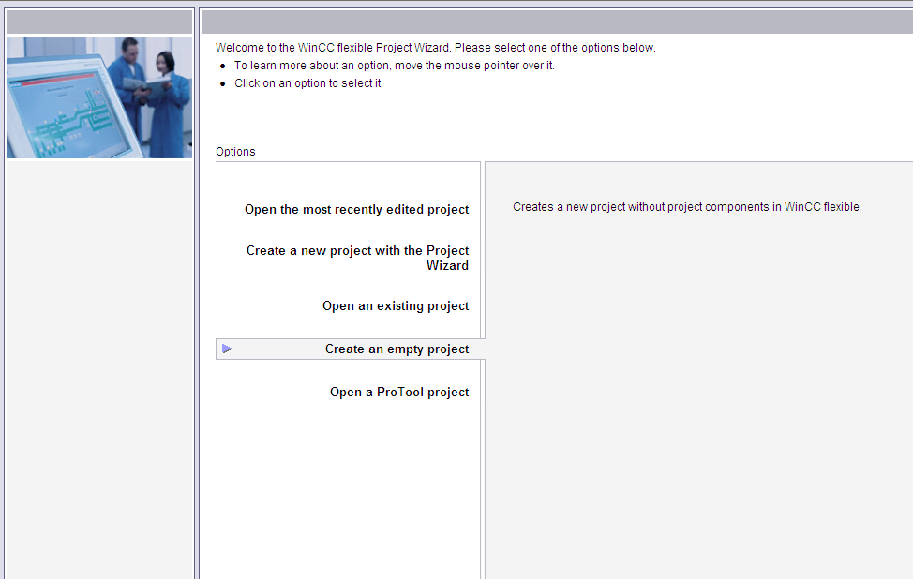
Communication to a Siemens HMI
WinCC flexible 2008 SP2

Slide 11
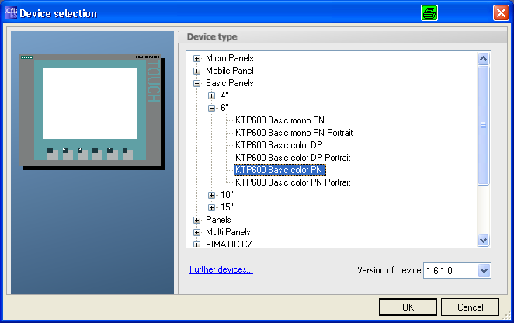
Communication to a Siemens HMI
WinCC flexible 2008 SP2
Select the HMI panel you want to use

Slide 12
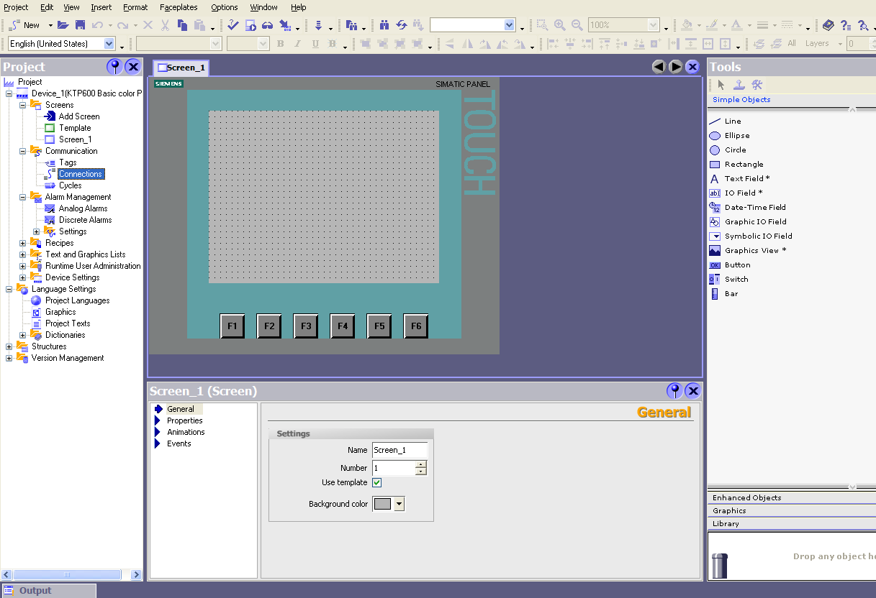
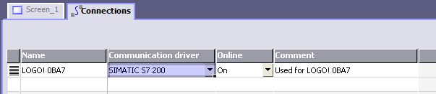
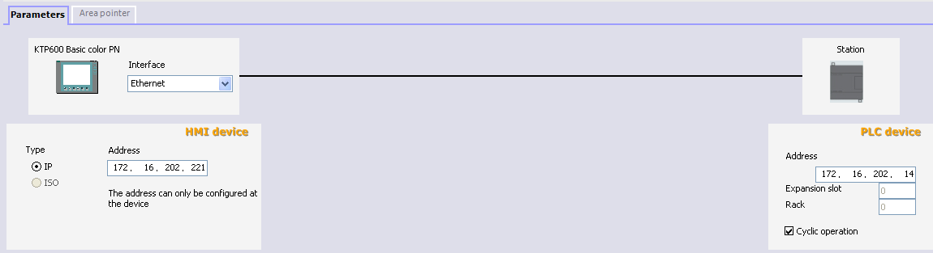
Communication to a Siemens HMI
Siemens HMI with LOGO! 0BA7
2
1
1
Select Connection
3
4
2
Select S7-200 as communication driver
3
Enter IP-Adress of HMI Panel
4
Enter IP-Adress of LOGO! 0BA7

Slide 13
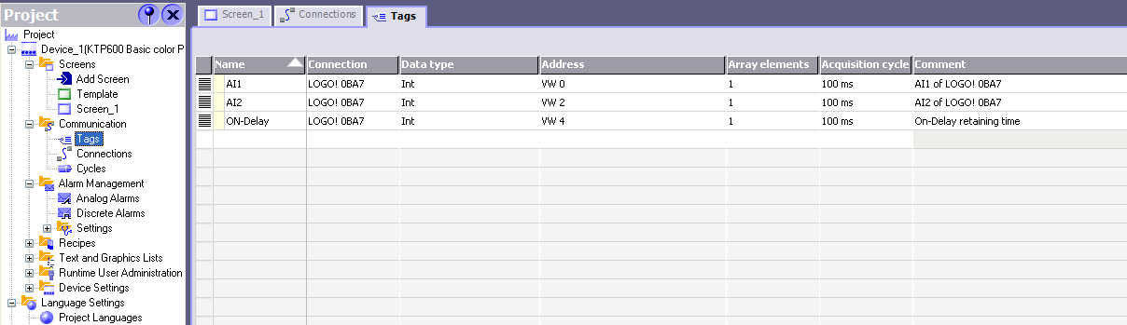
Communication to a Siemens HMI
Siemens HMI with LOGO! 0BA7
2
3
1
1
Select Tags
3
Be sure that data type and address are the same in WinCC flexible Tags and LOGO! VM-Mapping table
2
Enter the values specified in the LOGO! VM-Mapping table

Slide 14
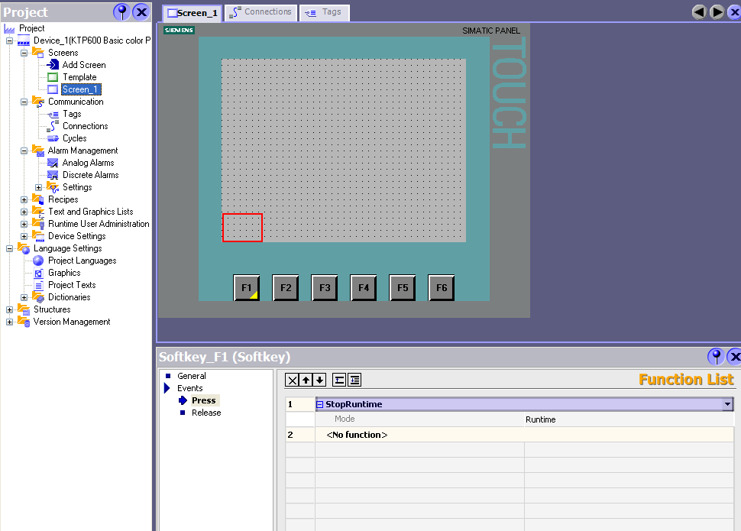

Communication to a Siemens HMI
Siemens HMI with LOGO! 0BA7
1
2
3
4
1
Select Screen_1
3
Select event “Press”
2
Double click on F1
4
Select “StopRuntime” (other functions)

Slide 15
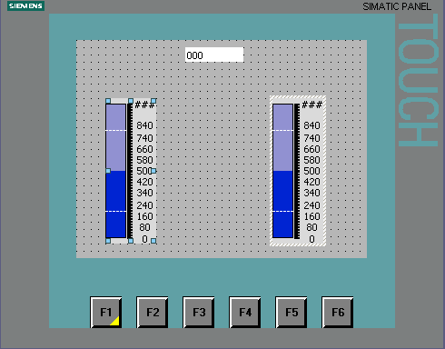
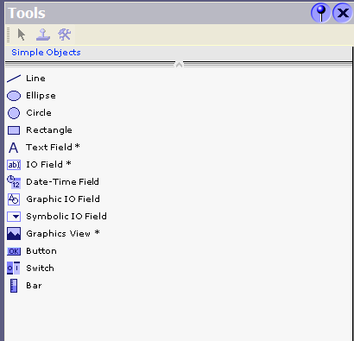
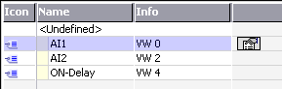
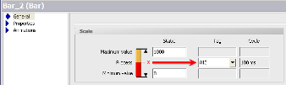
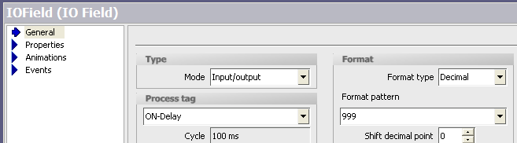
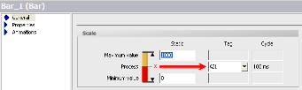
Communication to a Siemens HMI
Siemens HMI with LOGO! 0BA7
1
3
2
1
2
2
1
Place 2 bar graphs and a IO Field
2
Select the right Tag for each control

Slide 16
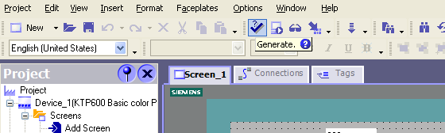
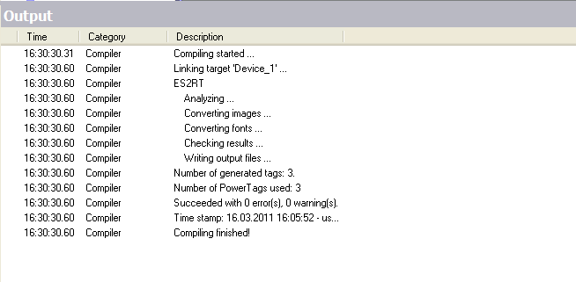
Communication to a Siemens HMI
Siemens HMI with LOGO! 0BA7
1
2
1
Press “Generate” to compile and check the project
2
Check for errors

Slide 17
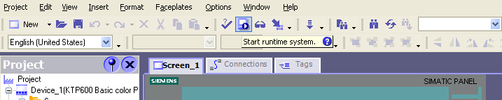
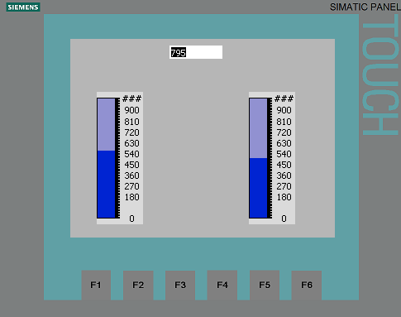
Communication to a Siemens HMI
Siemens HMI with LOGO! 0BA7
1
2
1
Press “Start runtime system”
2
Check your HMI configuration

Slide 18
LOGO! 0BA7 Hands-On-Training
Thank you for your attention!
H. Schindler
I IA AS FA PS4
Phone: ++49 (0)911 / 895 - 3665
E-Mail: Helmut.schindler@siemens.com

